Slide 1

Curriculum Meeting 2026
Welcome to the start of a new academic year at Riverbridge Primary School.

Slide 2
Welcome to Year 2
Year Group Leader: Miss Hall
Teachers: Miss Hall, Mrs Ingram & Miss Jordan
HLTA: Miss Russell & Miss Hames
Headteacher: Mr Grimwood
Deputy Headteacher: Mrs Price
Phase Leader: Mrs Talkington
Inclusion Leader: Miss Code
Pastoral Team: Mrs Wallace, Mrs Hughes, Mrs Lenton-Clark

Slide 3
The School Day
The gate and classroom doors open at 8:35am – 8:50 am.
Parents will continue to drop off at the gates and children will walk independently to their classroom. Any non-urgent messages can be passed through the school office.
Children are collected from the classroom door at 3:20 at the end of the day. The gate closes at 3:30.

Slide 4
Breaktimes
Morning break times will be from 10.40-10.55.
At PAB, the children will share the playground space but also have access to the large field area depending on the weather.
Children can play football on Mondays. Please keep an eye on the newsletter as children may be asked to bring a change of shoes as the weather changes.
Children do not need to bring in fruit from home as we provide this.
Lunchtime will be from 12:00 – 1:00pm.
Please ensure you have ordered your child a lunch online.

Slide 5


Equipment
Children should bring a Riverbridge Book Bag and a water bottle to school. They may bring an additional bag for enrichment clubs.
They do not need to bring their own stationery.
Please avoid sending in toys from home as these may get lost or broken.
From Year 3, they will be able to bring a Riverbridge rucksack or a rucksack of their choice.

Slide 6
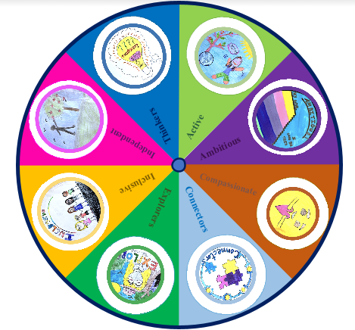
Behaviour
Stay on Green
Green tokens and green time
Gold leaves
Reflection time
Motto: ‘Being our Best.’
8 Great Values

Slide 7
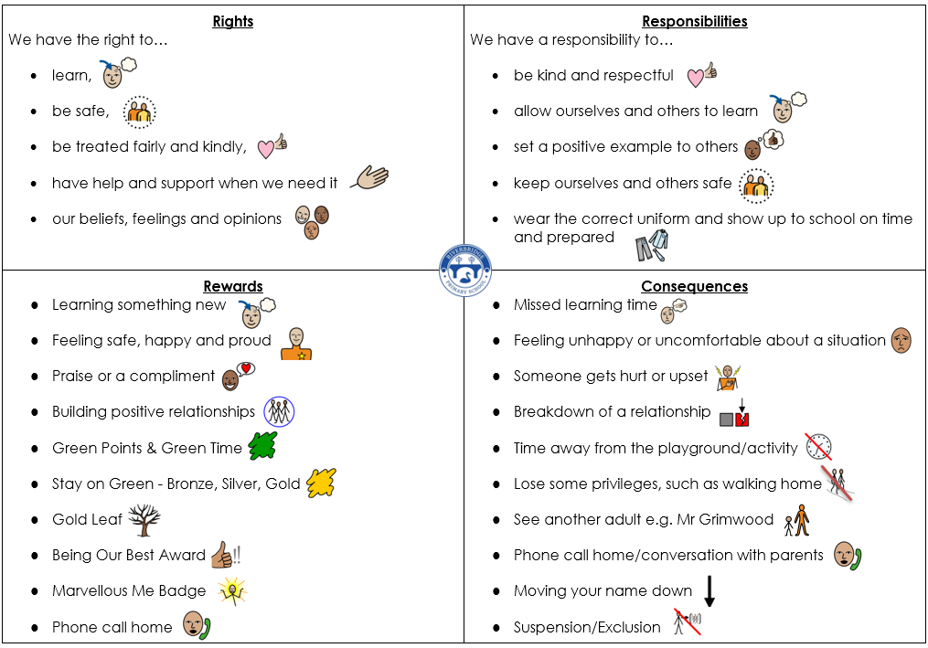
Behaviour

Slide 8
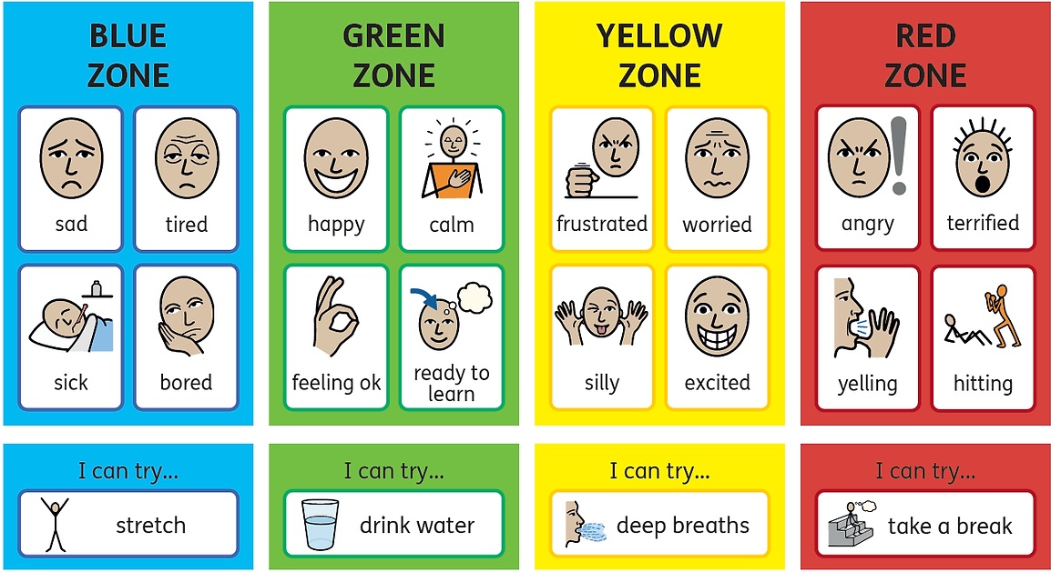
Wellbeing – Zones of Regulation
Children have access to a calm corner space in their classroom to help them stay in the green zone, ready for learning.

Slide 9
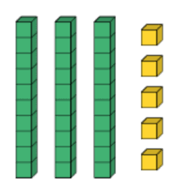

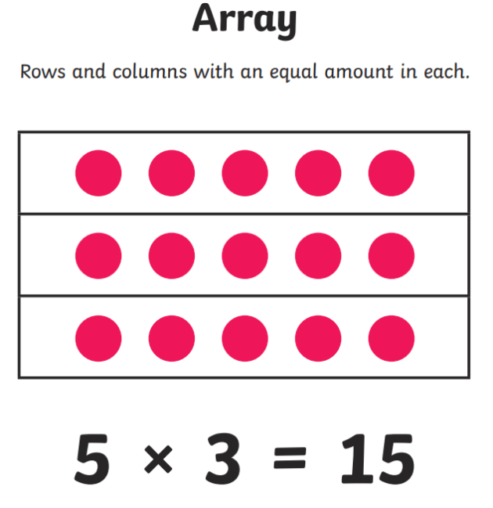


Maths in Year 2
Key resources and visuals we use:
X X X X
Place value
Addition and Subtraction
Shape
Multiplication and Division
Money
Measurement (Length, Height)
Measurement (Mass, Capacity, Temperature)
Fractions
Time
Statistics
Position and Direction

Slide 10
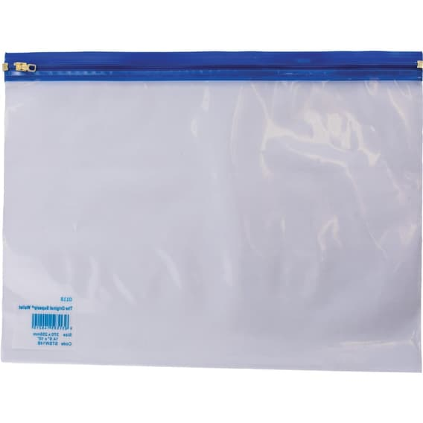

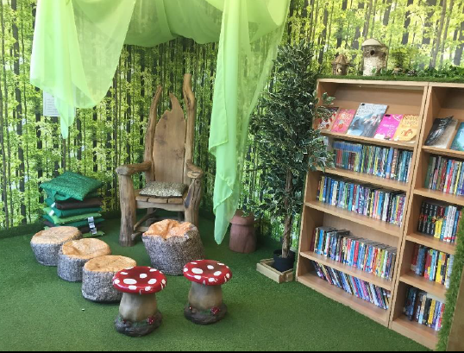



Reading
We really appreciate any additional reading that can be done at home to support your child on their journey in learning to read. Please record any reading at home in the yellow reading record.
There are three types of book that your child may bring home:
Reading Practice Book – Only for children finishing the Little Wandle Phonics programme
Colour-Banded Book
Library Book
A reading practice book (blue wallet). This will come home on a Thursday and must be returned in the wallet on a Monday. This book has been carefully matched to your child’s current reading level.
Your child will be able to read this mostly on their own but might need support with some sounds or tricky words. They can change this book independently. We encourage them to read it 2-3 times to support fluency and comprehension.
Children will choose a book from our library on Tuesdays and bring it home. They will need an adult to read this to them or with them. This is to encourage reading for pleasure so this book is for you to enjoy together.

Slide 11
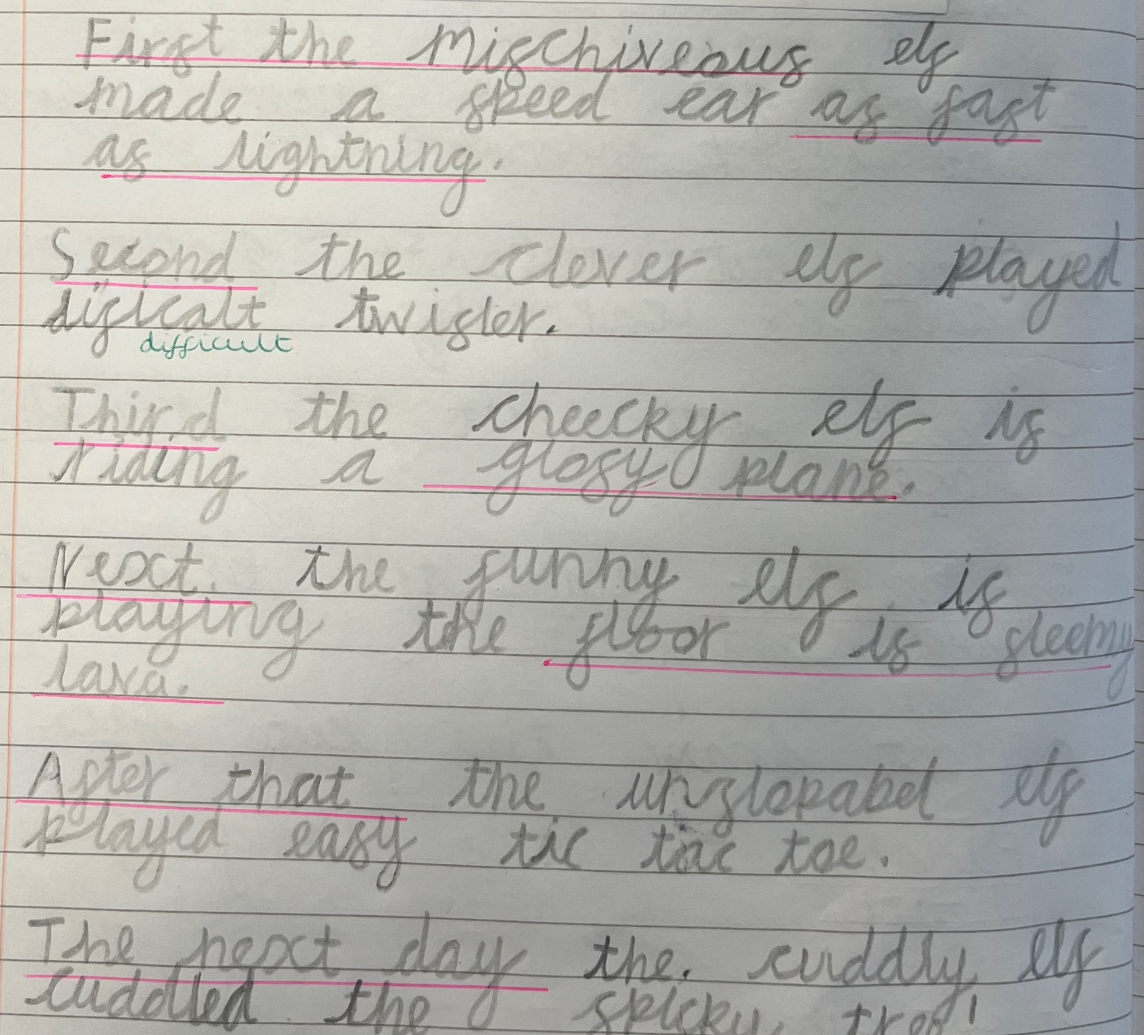

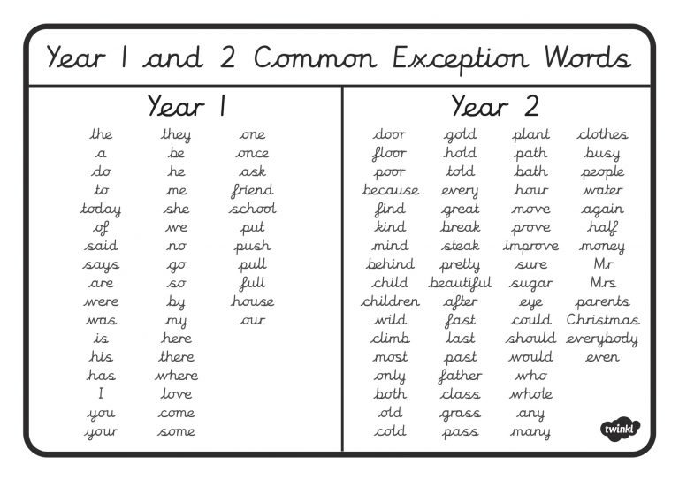

Writing
Handwriting
Children in Year 2 will begin to learn to join their letters.
Sentence Structure
We use colourful semantics to teach children to structure their sentences.
Spelling
Children will be taught to use phonics and spelling rules to spell words. They need to learn to spell some words by heart:
Punctuation
Children will learn to use full stops, capital letters, exclamation marks and question marks. They will begin to use commas when writing lists. They will also learn to use apostrophes for contraction and possession.

Slide 12
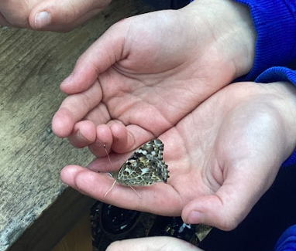
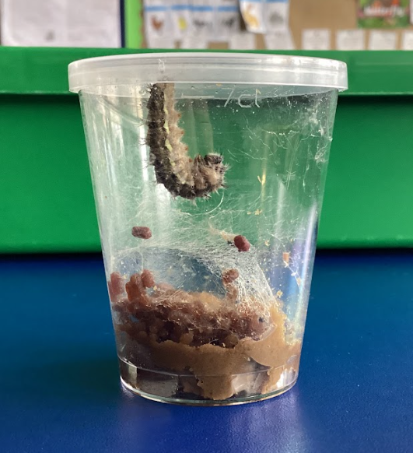
Science in Year 2
Identify and classify animals
Materials
Plants
Humans
Animals & Their Offspring
Living things and their habitats

Slide 13
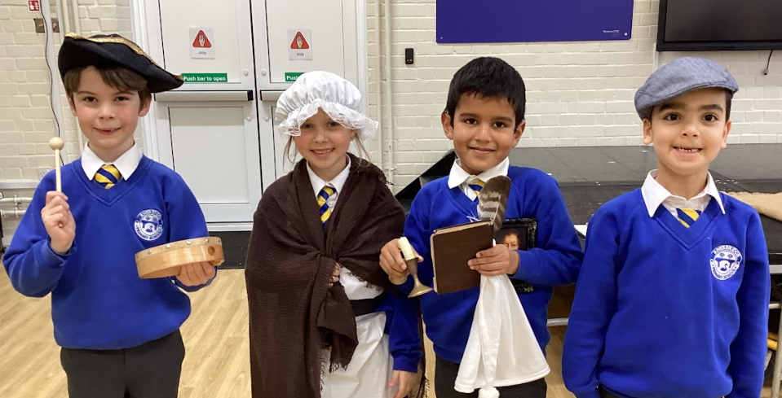
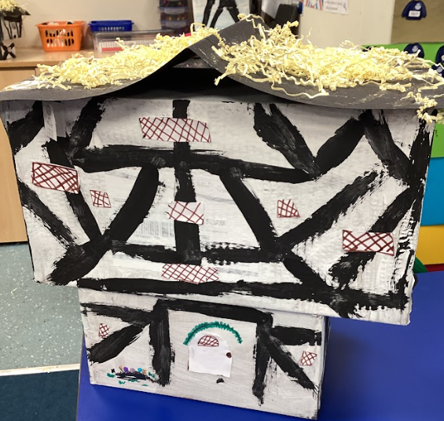

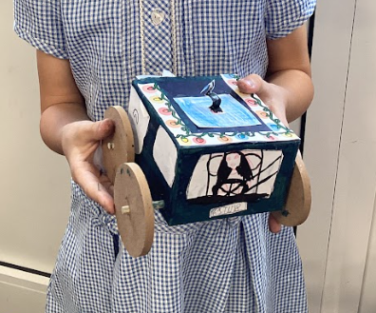

Other exciting curriculum areas…
Towns, Cities, Coasts & Countryside
Great Fire of London (Tudor Houses)
Africa
Transport through Time (Brooklands Museum)
Continents and Oceans
Significant Women in History

Slide 14
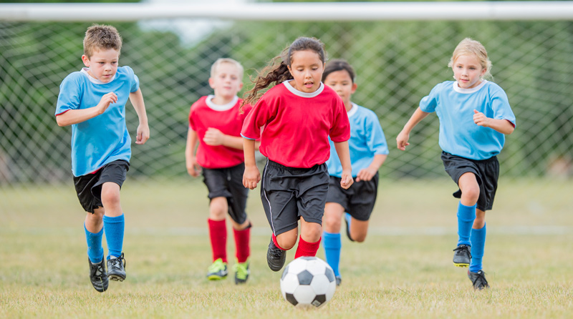
PE in Year 2
PE will be taught on Mondays.
Children must remove their earrings before taking part in PE.
Children should wear their PE kits into school.

Slide 15
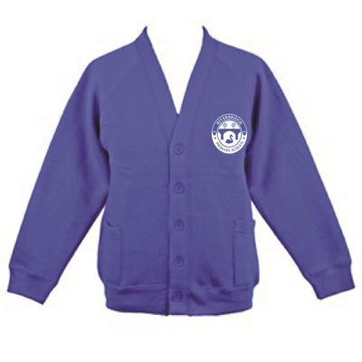
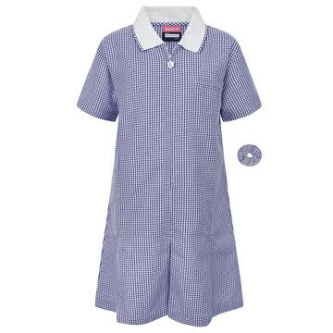
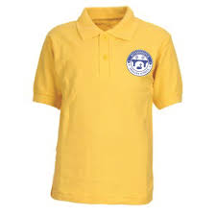
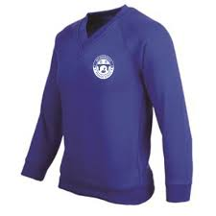

Uniform
Please ensure they have a waterproof coat in school every day in the autumn, winter and spring seasons in case of rain or outdoor learning activities. In the summer, they should bring a sun hat to school.
More information on our uniform can be found on our school website.

Slide 16
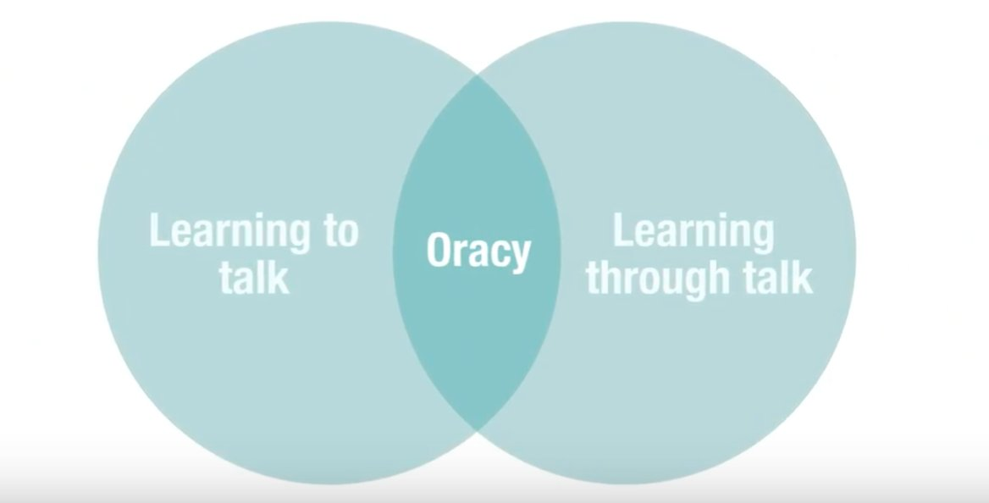
Oracy
This is still a priority for Riverbridge this year.
In the classroom context, oracy is both learning to and through talk. It is through talk that students have the opportunity to develop and share their understanding, through interactions with both teachers and peers. However, to do this effectively, students must also be taught to talk effectively, ensuring they have the necessary skills and understanding to engage in talk for learning.

Slide 17
Assessment in Year 2
The curriculum aims for pupils to ‘meet’ year group expectations.
Working Below
Working At (Just at or Securely At)
Exceeding
Your child’s progress will be shared at parents’ meetings and in an annual report.
In the summer term, the children will partake in end of key stage assessments using the optional SATS. These are carried out informally and are used to inform teacher judgement for assessment levels only.
Children who did not reach the pass mark for the Year 1 Phonics Screening will retake this in the summer term.

Slide 18
Home Learning in Year 2
Home learning will be sent out via Google Classroom on a Thursday and be returned on the following Tuesday.
Later this year, children will begin to receive project homework. This is called the , a Home Learning Review and will be uploaded to Google Classroom in Autumn 2. This includes a wide range of tasks linked to learning from the previous half term. Children are expected to do at least one task each half term. More information will be sent out for this.
We will be updating our home learning offer this term for maths and spelling. More information will be shared soon.
Children are expected to read as often as possible and to have this recorded in their reading record.

Slide 19
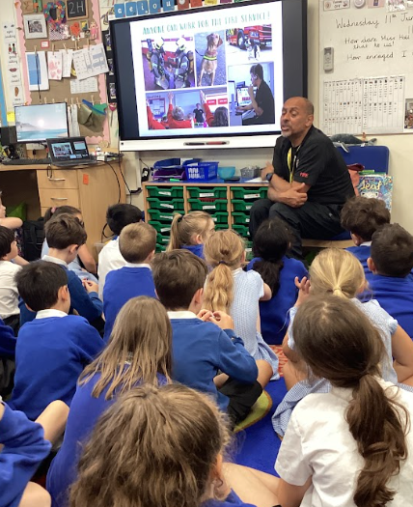
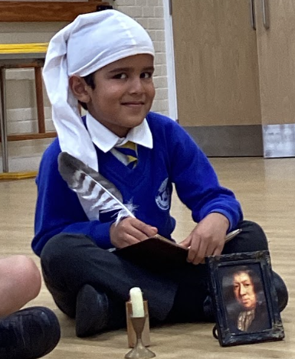
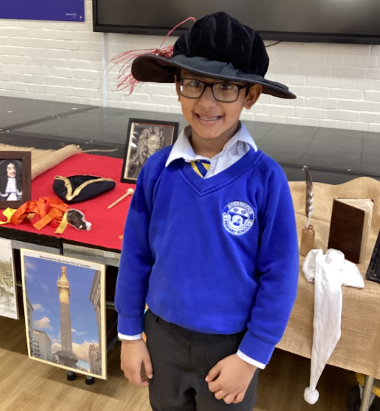
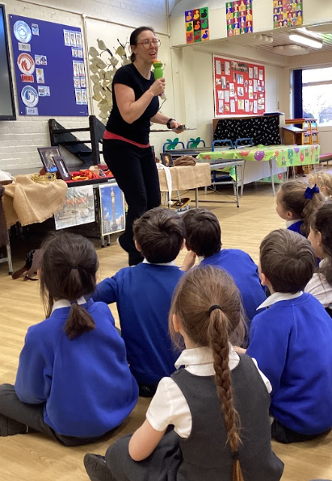
Trips in Year 2
Freshwater Theatre Company (GFoL)
Brooklands Museum (New for 2026!)
Surrey Fire and Rescue Safety Talk

Slide 20
Parental Empowerment
At Riverbridge, we want all parents to feel empowered to be a part of school life. If you wish to discuss anything, please do so via the office or arrange an appointment with the class teacher.
Each half term, a curriculum map will outline the curriculum being taught. These will be added to Google Classroom and the school website.

Slide 21
Thank you for listening and we are looking forwards to working with you and your children this year!

